Slide 1
Changes in Data Use Agreements for Research
Alicia Libla, JD, CRA
University Director, Research Contracting | Office for Research Administration, Indiana University
Deb Broach, MSN, RN, CHRC, ACRP-CP, CCRC
Director: Clinical Research, Indiana University Health
Associate Director: Office of Clinical Research

Slide 2
Master Data Sharing Agreement between Indiana University and Indiana University Health

Slide 3
What does the master cover?
Access to/sharing of data obtained from IU Health electronic medical record (EMR)
For Participation in or Recruitment to a research study
Approved by the IRB under a "Waiver of Authorization"
Note: The master agreement does not address the sharing of data obtained under an informed consent.

Slide 4
Do I need a DUA for transfer of IU Health data?
Is the data remaining at IU to be used only by IU faculty/staff?
Yes – then no, a DUA is not required.
No – then yes, a DUA is required.
Key takeaway: If the data is leaving IU or access to that data is being granted to a non-IU employee, a DUA is required.

Slide 5
Do I need External Data Sharing Subcommittee (EDSS) approval?
Yes, if:
sharing identifiable data with non-IU faculty/staff; or
sharing data obtain from IU Health EMR with a for-profit/commercial entity.
No, if:
sharing de-identified or limited data set with a non-profit/non-commercial entity; or
data was gathered under an informed consent.
Note: If sharing identifiable data, an IT Risk Assessment (ITRA) for the location/system to which the identifiable data will be shared will be required prior to EDSS approval.

Slide 6
Relevant IU Health Policies

Slide 7
Policies
IU Health Policies pertaining to research can be found on the Office of Clinical Research website or through IU Health’s PolicyTech Platform:
Enterprise Data and Analytics Data Sharing Policy
Clinical Research Recruitment
Access to Health Data and Information for Research Purposes
Research

Slide 8
IU Health External Data Sharing Subcommittee (EDSS): Process

Slide 9
IU Health EDSS Submission
Email DatasharingRequests@iuhealth.org to begin the submission process.
You will receive an SBAR from DataSharingRequests@iuhealth.org
SBAR: Situation, Background, Assessment, Recommendation
SBAR is a written communication tool that helps provide essential, concise information to assist EDSS to make decisions about your data sharing request.
SBAR templates are frequently updated. Be sure to use the version provided by DataSharingRequests@iuhealth.org
Complete the SBAR and send it back to DataSharingRequests@iuhealth.org by the second Monday of the Month, in order to be considered for review at the monthly meeting taking place on the third Monday of the month.

Slide 10
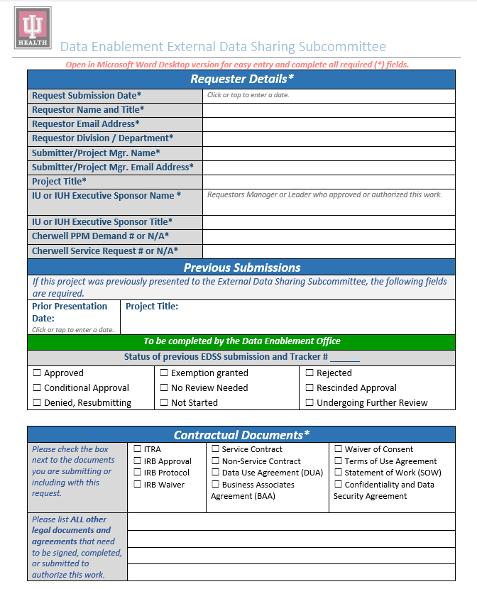
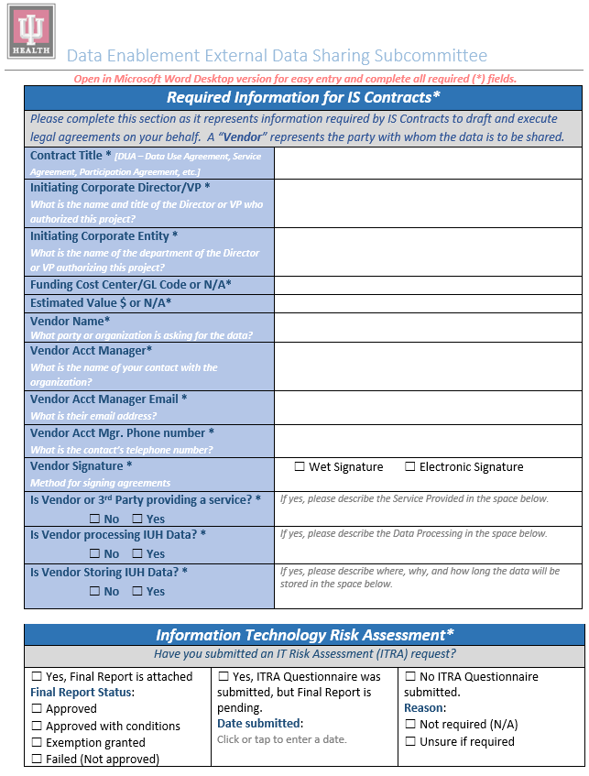
IRB Submission Title
For sharing of data for research purposes, IRB approval at minimum is required. The approval will provide documentation of any waivers that have been approved. If you don’t have an IRB approved protocol, a copy of IRB submission is helpful
An IT Risk Assessment is required if identifiable information will be shared. To avoid delays in approvals, reach out to ITRA@iuhealth.org to determine if ITRA is required.

Slide 11
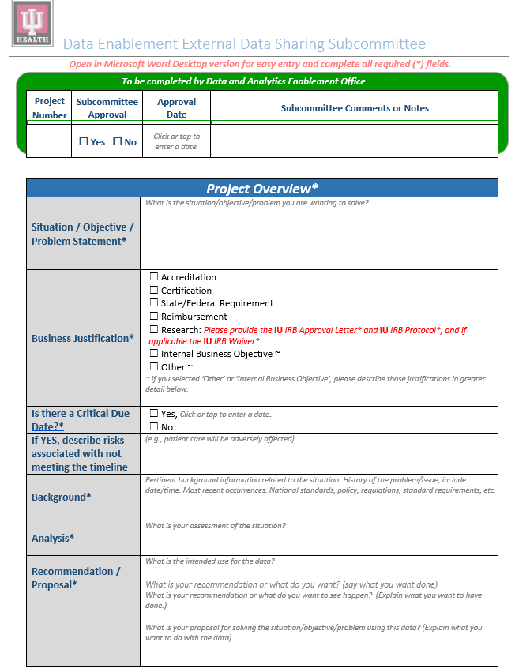
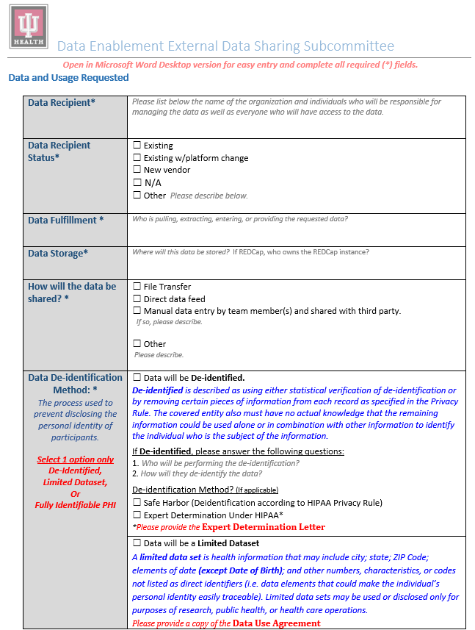
Although de-identified data is no longer subject to HIPAA rule, IU Health will still require that IU ORA execute an agreement with the data recipient.
A different type of agreement will be negotiated by IU ORA based on the type of data being shared.
A Data Use Agreement (DUA) is applicable for a limited data set only.
Carefully review the data elements to determine which selection to make

Slide 12
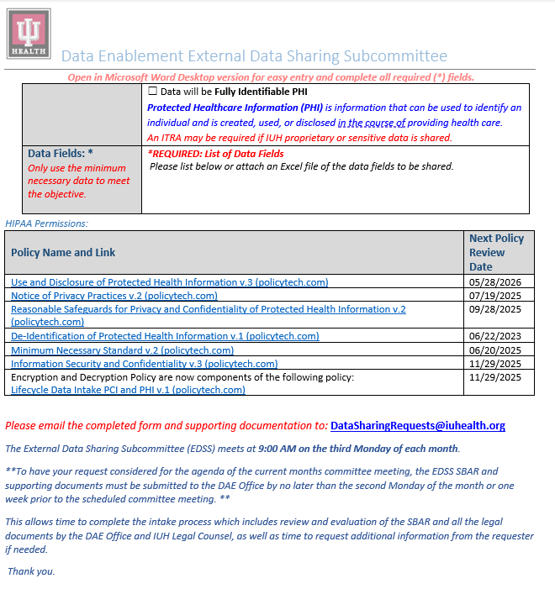
Tips for completing the SBAR
Sharing of data as part of an industry sponsored retrospective data study will require EDSS Review
Ensure that your IRB submission includes the data being shared in the “brief summary
Complete the Data Fields section even if the data is outlined in the protocol.
Complete each section fully.
Once you receive a Tracker number, use that number when responding to datasharingrequests@iuhealth.org
One of the most common issues is that data being shared is listed as De-identified when dates (other than year) are being shared
Place a hold on your calendar for 9am on the third Monday of the month to keep your calendar free.
Continued from previous page

Slide 13
IU Health EDSS Pre-review
After the SBAR is received, the submission will be reviewed by The DAE (Data and Analytics Enablement) Office and IU Health legal counsel at a scheduled meeting between the 2nd and 3rd Monday of each month
The SBAR and other documents are reviewed to ensure that the committee has all the information necessary to make a decision about the request.
You may receive an email during this time to request additional information, suggest revisions to your SBAR or clarify any information
Once the review is completed and SBAR is approved for the agenda, an invitation will be sent to attend the EDSS meeting.
This is a virtual meeting through Microsoft Teams. The invite will come from Kurt Olhausen, Committee Chair of EDSS

Slide 14
IU Health EDSS Meeting:
The team working with you on your request is welcome to join the meeting for your presentation.
Once your request is approved to go on the agenda, you will have the opportunity to provide the names, titles, and email addresses of the additional attendees so that they can be added to the meeting invitation.
Each project on the agenda is allotted 15 minutes.
For the purposes of privacy, compliance, and data security, each project along with their group of requesters is admitted to the meeting from the lobby one agenda item at a time.
Presentations to the committee should begin with a brief 3 to 5 minutes overview of the request. The committee members will ask questions during and after the presentation to evaluate whether the proposed data sharing falls within acceptable guidelines for IU Health.
The decision about whether to approve the request is made during the 15 minutes allotted for each request, so you will know the decision of the committee before you leave the meeting.
Your group will be dismissed from the meeting once a vote is taken and a decision is made.

Slide 15
IU Health EDSS Approval: Next Steps:
You will receive an email following the meeting with an updated SBAR attached officially documenting the decision of the committee.
This approval, along with the IRB Approval with documented waiver of authorization, allows IU’s Office for Research Administration to negotiate the appropriate agreements per the master data sharing agreement.

Slide 16
IU Health IT Risk Assessment (ITRA)
Required when identifiable data will be housed outside of IU or IU Health.
Email itra@iuhealth.org to begin the process.
A member of the data security team will send a scoping document. This document will assess the need for a full IT Risk assessment.
If a full ITRA is required, a workbook will be provided to requester along with the data recipient’s technical support team.
Upon completion of the ITRA, you will receive a decision from Data Security.

Slide 17
Data Use Agreement (DUA) Request Process (External sharing/access only)

Slide 18
Submit CRF to ORA
Complete the data use agreement section of the Office for Research Administration (ORA) Contract Request Form (CRF) in its entirety, including a description of the data to be provided to/accessed by the external party.
Attached a copy of your IRB waiver of authorization approval and a copy of your EDSS approval (if applicable) to the CRF. Note: IRB and EDSS approval (if applicable) must be obtained prior to submission of the CRF. Incomplete CRFs will be returned.
Submit your completed CRF to ORA.
ORA will negotiate the appropriate agreement based on the approvals.

Slide 19
Contact Information
IU Office for Research Administration: oraresco@iu.edu
IU Health Clinical Research Support: clinicalresearchsupport@iuhealth.org
External Data Sharing Subcommittee: datasharingrequests@iuhealth.org
IU Health IT Risk Assessment: ITRA@iuhealth.org

